Slide 1
Attractions in Bath
By: Pedro Amado, Tomas Paladino, Felipe Rolon, Lautaro Severina, Valentin Hernan y Santiago Cid

Slide 2
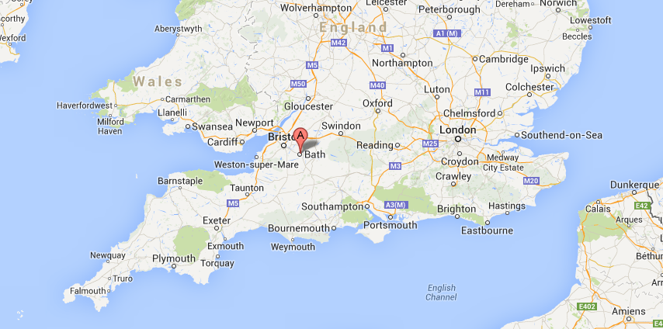
Location

Slide 3
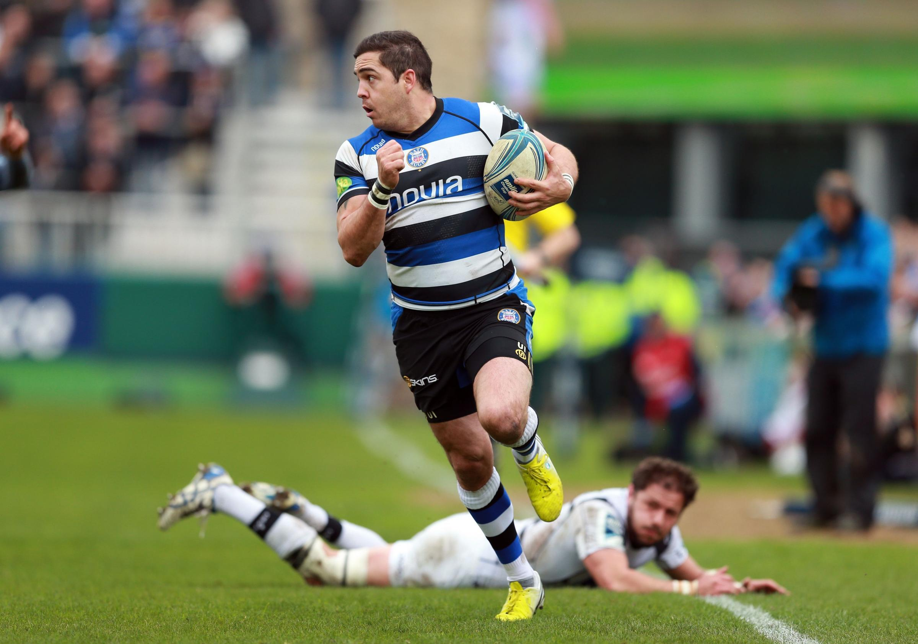
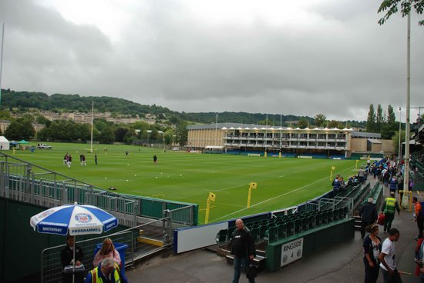
Bath Rugby Stadium
Capacity : 12.300
Name: The Recreation Ground

Slide 4
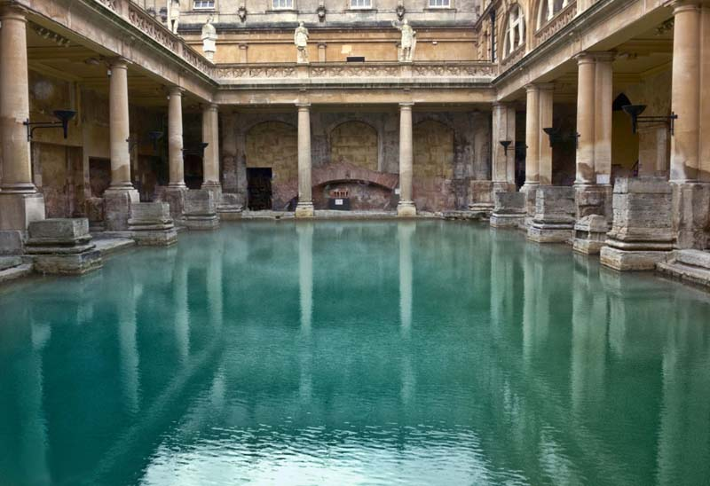
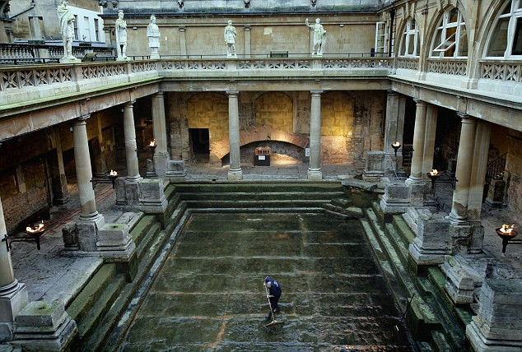
Roman Baths

Slide 5
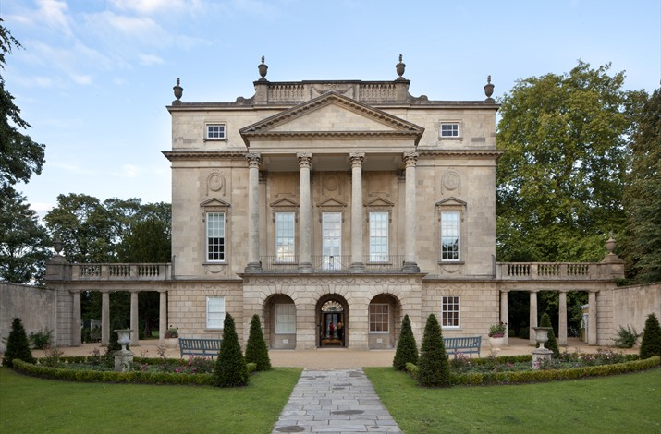
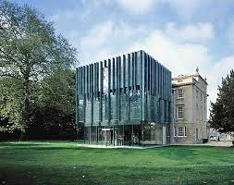
Holburne Museum (Art museum)

Slide 6
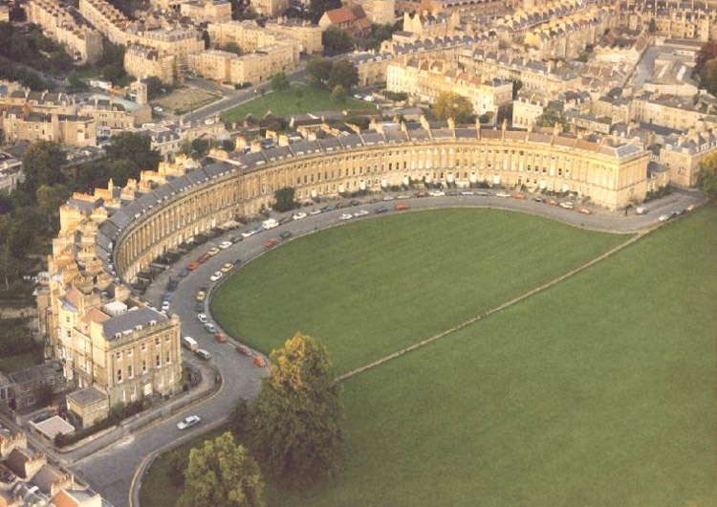
Royal Crescent

Slide 7
Panoramic picture
The Royal Crescent is a row of 30 terraced houses laid out in a sweeping crescent in the city of Bath, England. Designed by the architect John Wood the Younger and built between 1767 and 1774

Slide 8
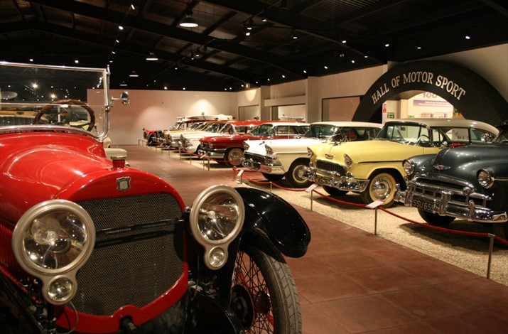
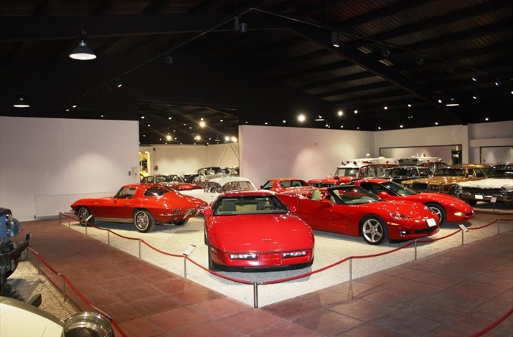
Haynes International Motor Museum

Slide 9
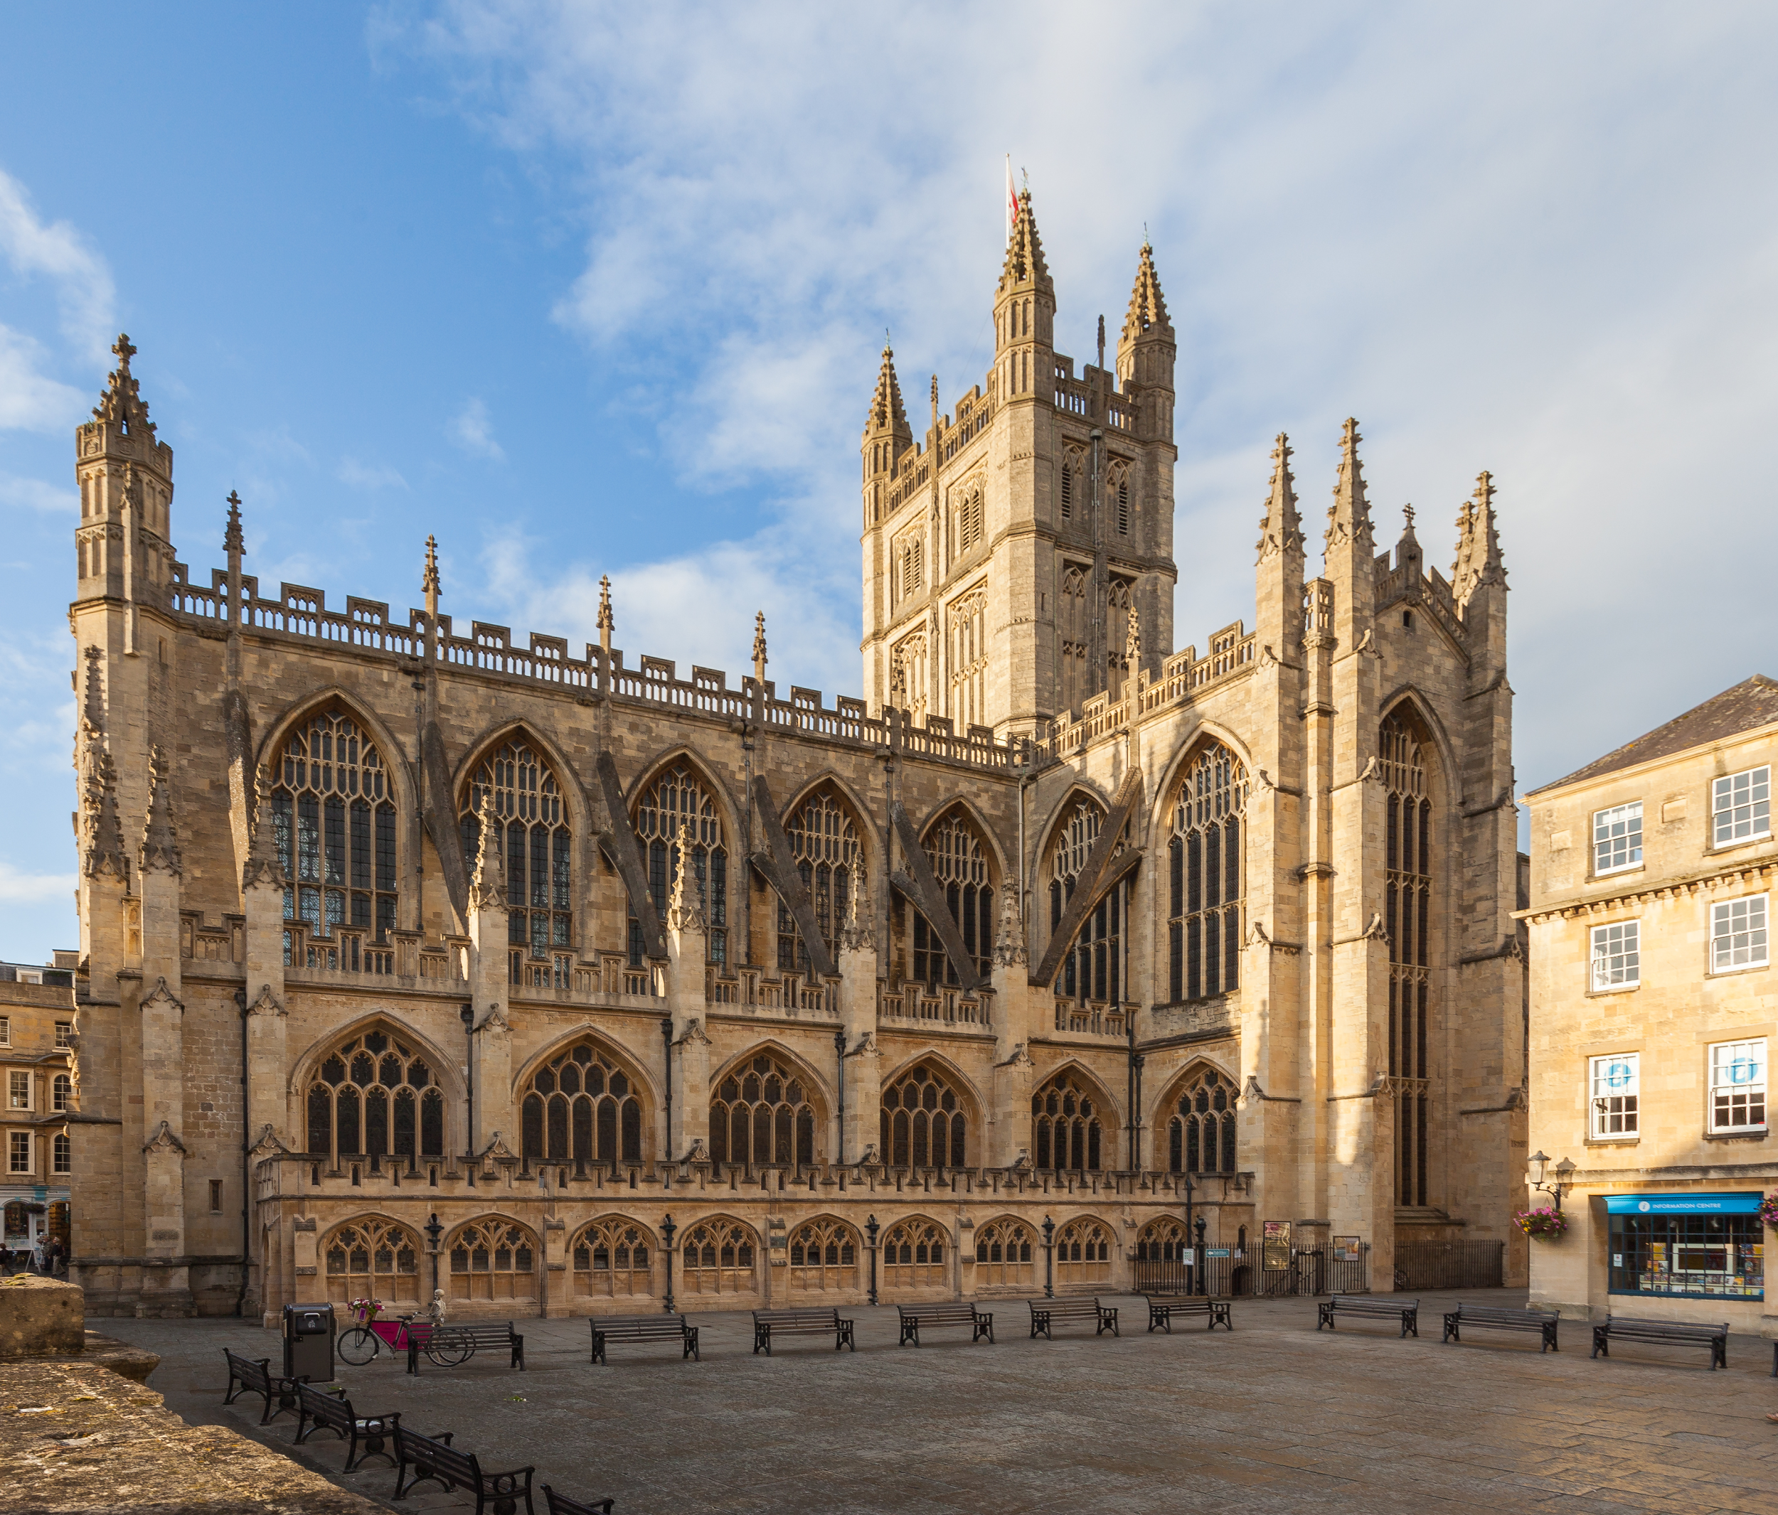
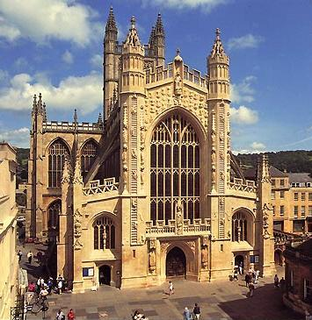
Bath Abbey
The Abbey Church of Saint Peter and Saint Paul, Bath, commonly known as Bath Abbey, is an Anglican parish church and a former Benedictine monastery in Bath, Somerset, England. Founded in the 7th century.

Slide 10
TO BE CONTINUED…. IN SEPTEMBER - OCTOBER

