Slide 2
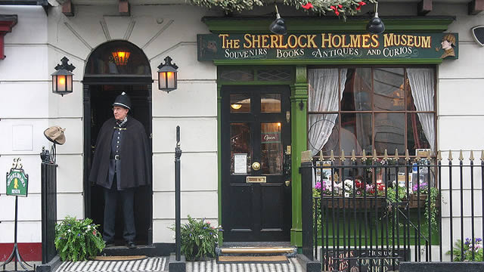
The world famous consulting detective Sherlock Holmes lived at 221b Baker Street according to the stories written by Sir Arthur Conan Doyle.
Open every day of the year (except Christmas Day) from 9.30am - 6pm
Admission: Adult £15 Child £10 (under 16yrs)

Slide 3
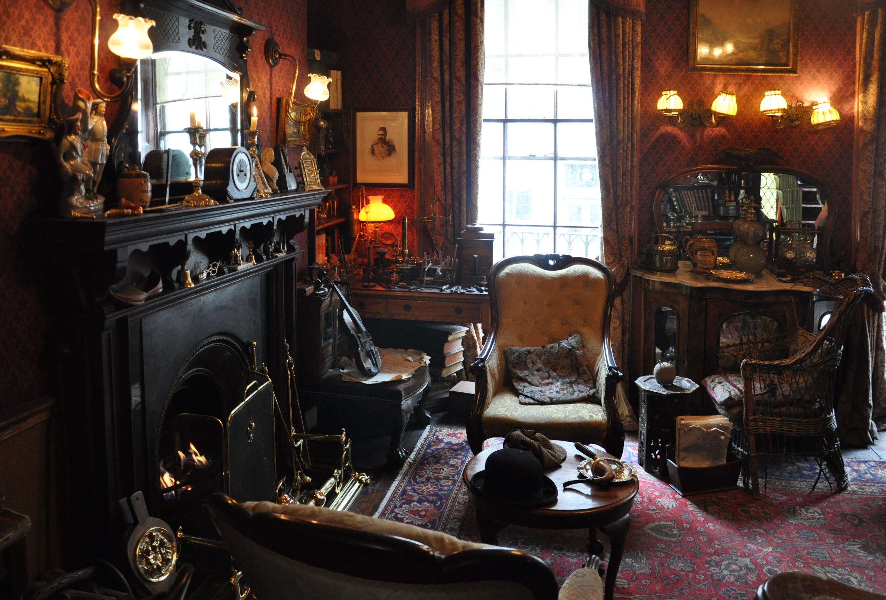
The house is protected by the government due to its "special architectural and historical interest" and the 1st floor study overlooking Baker Street is still faithfully maintained for posterity as it was kept in Victorian Times.

Slide 4
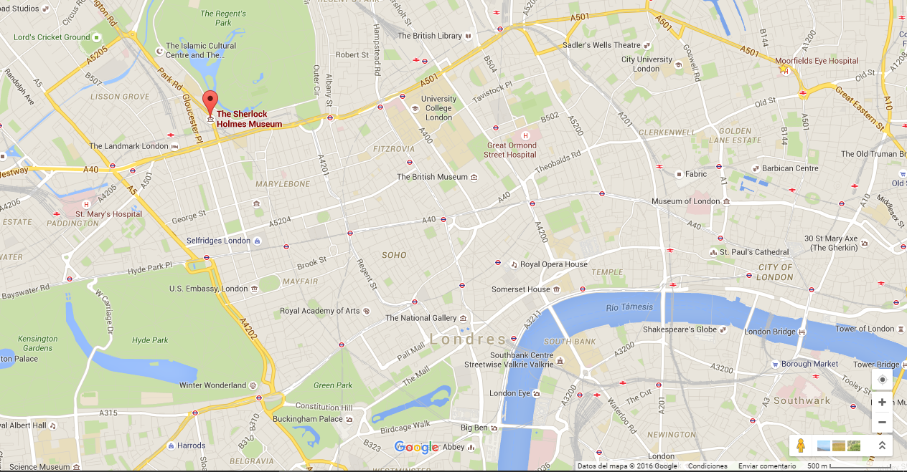

Slide 5
How to get there?

Slide 6
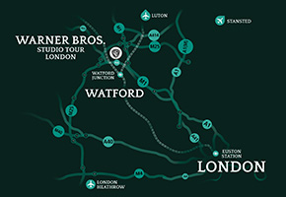
hp

Slide 7
Tour London
Have a magical day out with a behind-the-scenes tour of the Harry Potter films at Warner Bros. Studio Tour London.

Slide 8
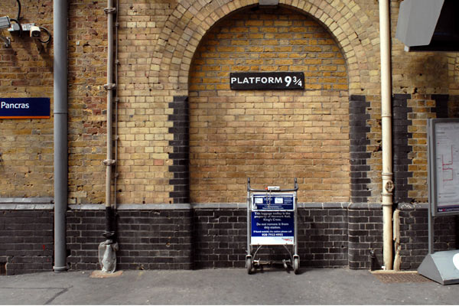
Platform 9¾ at King's Cross Station
A fun, free photo opportunity if you're passing through, this luggage trolley, half-embedded in a wall

Slide 9
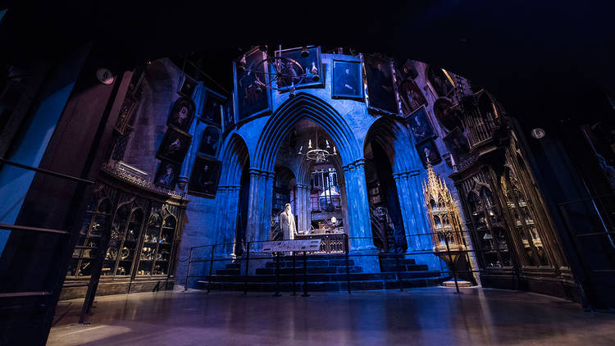
The Making of Harry Potter
Rail: Watford Junction rail then shuttle bus or a railway (one hour trip)
Price:£35 adults, £27 5-15s, free (ticket required) under-4s, £107 family

